Slide 1
COMP 3311 Database Management Systems
Lab 6. Oracle Indexing, Clustering and Further PL/SQL

Slide 2
Objectives of the Lab
After this lab you should be able to
Create an index for a table in Oracle
Create a cluster for tables in Oracle
Use more PL/SQL constructs for Database Programming

Slide 3
Getting the lab SQL script file
Download the SQL script lab6.sql file (via the implicit link or from the course web site Lab page) into your folder
Execute the script in Oracle SQL Developer

Slide 4
Oracle Indexing 1
An index can be created in a database system to speed up record retrievals in the data file.
An index is defined on one or more columns of a relational table.
An index occupies extra space and is stored separately from the table.
Oracle uses the index only when the index is estimated to improve the performance of record retrievals.

Slide 5
Oracle Indexing 2
In Oracle, a unique column parameter ROWID is used to identify records internally.
The key parameter of the index corresponds to the values of the columns on which the index is created.
When an index is created, the index entries will hold the values of key and ROWID of the records.

Slide 6
Oracle Indexing 3
Whenever appropriate, the Oracle system uses the index to search for records.
Since the index is stored in a balanced tree, data retrieval from the index is faster.
The ROWID values obtained from the index will be used by the Oracle system to directly locate the record in the file system.
The efficiency of searching records in a large table can be much improved by using indexes.

Slide 7
Oracle Indexing 4
The syntax for creating an index is as follows:
CREATE [UNIQUE] INDEX index_name ON table (column1, column2, …);
The UNIQUE keyword specifies that the column(s) must have unique values. (note: the use of UNIQUE is optional)

Slide 8
Oracle Indexing 5
CREATE UNIQUE INDEX facility_idx ON facility (department_id, name);
The above statement creates an index on the department_id and name columns of the table facility.
The tuple (department_id, name) must be unique in facility.

Slide 9
Oracle indexing 6
Oracle does not always use the index. An index is not be used in the following scenarios:
The SELECT statement does not contain the WHERE clause:
Example: SELECT * from facility;
The SELECT statement contains the WHERE clause, but the WHERE clause does not refer to the indexed column(s):
Example: SELECT * FROM facility where no_of_computers = 60;
The indexed column(s) is/are modified by some function(s) in the WHERE clause:
Example: SELECT * FROM facility where substr(name,1,8) = 'Computer';

Slide 10
Oracle indexing 7
A function-based index can be created as follows:
CREATE INDEX function_idx ON facility (substr(name,1,8));
We can check the names of all the indexes created:
SELECT index_name FROM user_indexes;
We can also drop an index via a DROP statement:
DROP INDEX index_name;
To create the function-based index, the user must have the QUERY REWRITE system privilege.

Slide 11
Oracle indexing 8
When the Oracle database system is creating an (offline) index for a table, the table is locked, and will not be available for applications or users.
This can be undesirable in the real-world working environment.
Starting from version 8i, Oracle supports online indexing by using the keyword ONLINE:
CREATE UNIQUE INDEX facility_idx ON facility (department_id,name) ONLINE;
The advantage of online indexing is that it has minimal impact on applications or users. The database remains accessible during the index rebuild. However, online indexing requires more memory as a temporary index is created in memory during the process.

Slide 12
Oracle indexing 9
Creating an index could slow down the insertion and deletion operations.
If the table is to be updated frequently with the insertion and deletion statements, maintaining the index is a big overhead to the system.
Index is good for tables that are primarily used for querying and the indexed tables do not require to be frequently updated.

Slide 13
Oracle clustering 1
Oracle can store tables that are often used together (i.e. in JOIN operations) in the same data blocks. This is known as “clustering”.
Clustering reduces unnecessary I/O accesses, thus improves the performance.
To place tables in a cluster, the tables need to have a common column.
The user needs the CREATE CLUSTER privilege in order to create a cluster in the system ⁺.
⁺ Don’t worry if you do not have the privilege to create a cluster.

Slide 14
Oracle clustering 3
Step 1: Create a cluster
The syntax for creating a cluster:
CREATE CLUSTER clustername (column1 datatype, column2 datatype, …)
Example
CREATE CLUSTER department_facility (department_id varchar2(4));
The above example create a cluster named department_facility, department_id is known as the cluster key.

Slide 15
Oracle clustering 2
To create a cluster in Oracle, you need to refer to the following steps:
Create a cluster using the CREATE CLUSTER command.
Create an index on the cluster using the CREATE INDEX command. THIS MUST BE DONE BEFORE ANY RECORDS ARE INSERTED INTO THE TABLES.
Place the tables into the cluster with the CLUSTER option in the CREATE TABLE statement.

Slide 16
Oracle clustering 4
Step 2: Create an index
Oracle requires a cluster to have an index (otherwise record insertion will not be allowed).
But Oracle does not build an index automatically for a cluster.
The following statement creates an index department_facility_idx on the department_facility cluster:
CREATE INDEX
department_facility_idx
ON CLUSTER department_facility;

Slide 17
Oracle clustering 5
Step 3: Place tables into a cluster
The tables being put into a cluster must have a column that matches with the cluster key.
The following statement creates the departments table and put it into the cluster department_facility:
CREATE TABLE departments
(department_id varchar2(4) not null,
name varchar2(40),
room_number number(4))
CLUSTER department_facility(department_id);

Slide 18
Oracle clustering 6
In Oracle you cannot put existing tables into a cluster.
The tables are required to be put into the cluster when they are created.
To see the names of all of the clusters created we can use the following command:
SELECT cluster_name FROM user_clusters;

Slide 19
Further PL/SQL 1
Recall the basic structure (a block) of PL/SQL :
DECLARE
/* Declarative section: variables, types, and local subprograms. */
BEGIN
/* Executable section: procedural and SQL statements go here. */
/* This is the only section of the block that is required. */
EXCEPTION
/* Exception handling section: error handling statements go here. */
END;

Slide 20
Further PL/SQL 2 (additional flow control statements)
In addition to the control statements we discussed in the last lab, there are some more control statements in PL/SQL. The following include more such flow control constructs (highlighted in red):
Conditional control statements:
IF … THEN … ELSIF … ELSE … END IF;
CASE … WHEN … THEN … ELSE … END CASE;
Iterative statements:
LOOP … END LOOP;
WHILE … LOOP … END LOOP;
FOR … IN … LOOP … END LOOP;

Slide 21
Further PL/SQL 3 (exceptions)
In PL/SQL, an exception is an error condition that occurs during program execution. PL/SQL treats all errors that occur in an anonymous block, procedure, or function as exceptions. These exceptions can have different causes such as coding mistakes, bugs, and even hardware failures.
The code that you write to handle exceptions is called an exception handler. A PL/SQL block can have an exception-handling section (recall EXCEPTION in a block), which can have one or more exception handlers as follows.
EXCEPTION
WHEN exception1 THEN exception handler1 WHEN exception2 THEN exception handler2

Slide 22
Further PL/SQL 4 (exceptions)
Handling exceptions in PL/SQL
There are many possible predefined exceptions:
NO_DATA_FOUND – SELECT INTO statement returns no rows,
TOO_MANY_ROWS – SELECT INTO statement returns more than one rows, etc
For the complete listing of predefined exceptions, refer to the link: http://download.oracle.com/docs/cd/B10501_01/appdev.920/a96624/07_errs.htm
It is possible to have user-defined exceptions:
Declare and define an exception by the users
Raised explicitly by users using the RAISE command:
RAISE <exception name>;

Slide 23
Further PL/SQL 5 (exceptions)
To have a user-defined exception, we need to:
Declare the exception under the “DECLARE” section,
Raise it (whenever applicable) under the “BEGIN” section,
Define the codes under the “EXCEPTION” section.
We will show the use of a user-defined exception cga_too_low in a piece of PL/SQL code on the next slide.
The code checks a student with the email address ‘lamngok’.
If the cga value of that student is lower than 10 then a user-defined exception will be raised:
A message ‘LAM IS LAZY’ will be displayed to the screen.
The student’s last_name will be updated to ‘LAZY’

Slide 24
Further PL/SQL 6 (exceptions)
DECLARE
cga_too_low EXCEPTION;
cga_of_lam NUMBER(2);
BEGIN
SELECT cga INTO cga_of_lam
FROM students WHERE email='lamngok';
IF (cga_of_lam<10) THEN
RAISE cga_too_low;
END IF;
EXCEPTION
WHEN cga_too_low THEN
DBMS_OUTPUT.PUT_LINE('LAM IS LAZY!');
UPDATE students SET last_name='LAZY'
WHERE email='lamngok';
END;

Slide 25
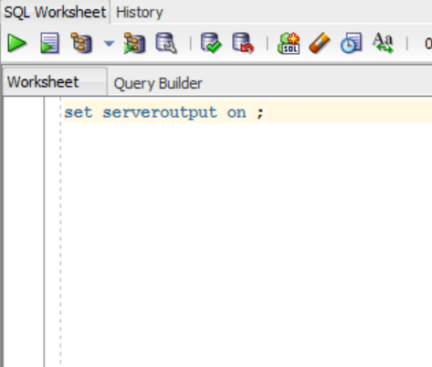
Running the example 1
First, set the server output on (run set serveroutput on; in a worksheet) as follows:
The output of the PL/SQL code will then be shown

Slide 26
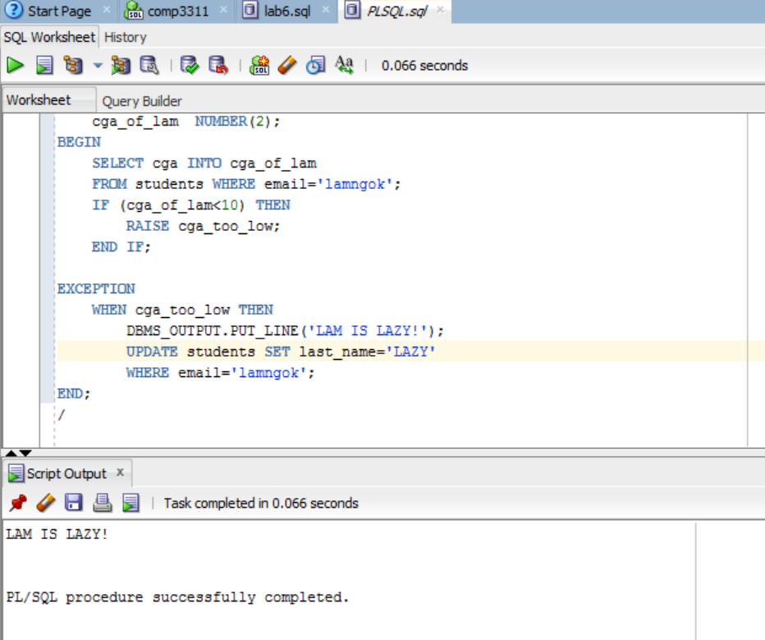
Running the example 2
Open the file lab6_exception.sql (download from the course web site Lab page). Run the code into SQL Developer. The result should show the output LAM IS LAZY!

Slide 27
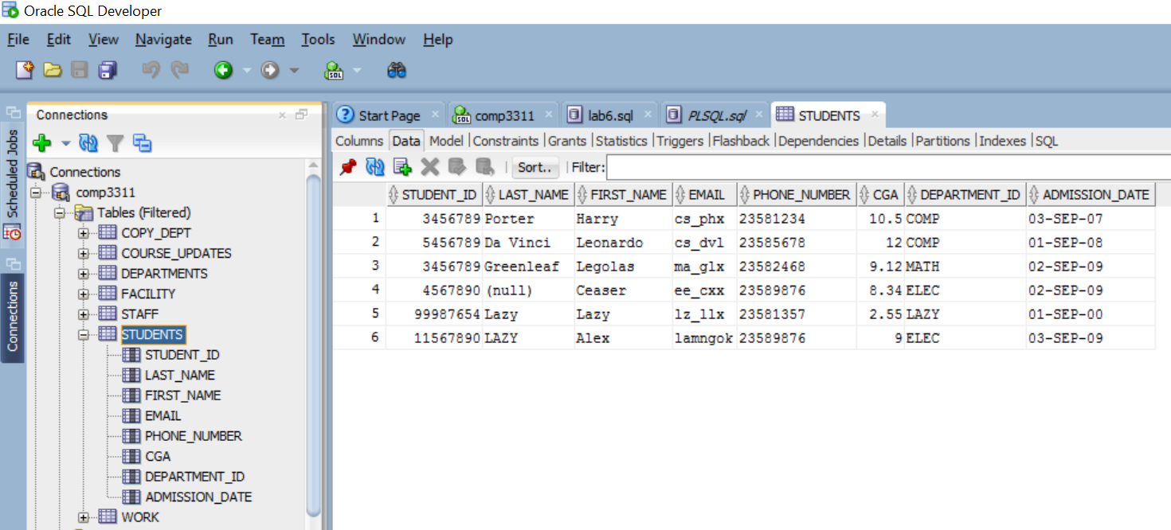
Running the example 3
The changes to the table can be observed (i.e. Last_name is updated: Lam → Lazy).

Slide 28
Conclusions
We covered the following topics in this lab:
Creating an index for an table in Oracle
Creating a cluster for tables in Oracle
Introducing more PL/SQL constructs such as exceptions

